Slide 1
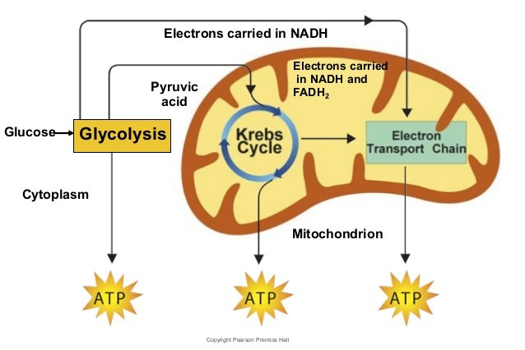
Overview of Cellular Respiration

Slide 2
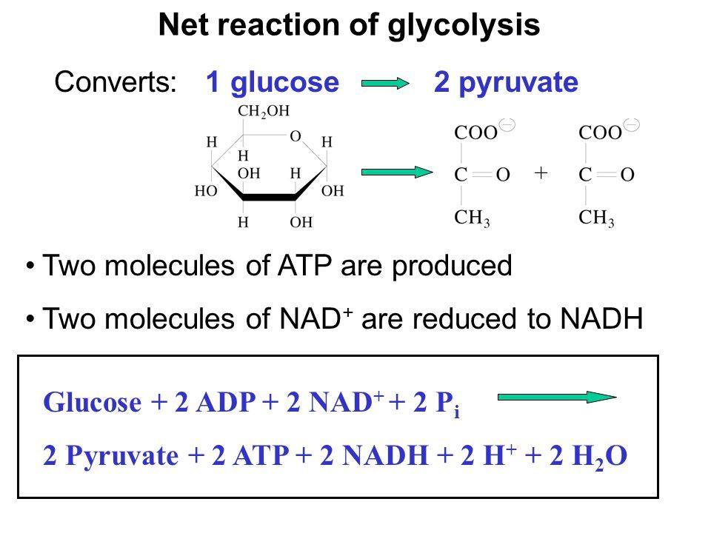
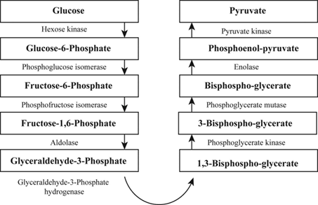
Major steps in Glycolysis

Slide 3
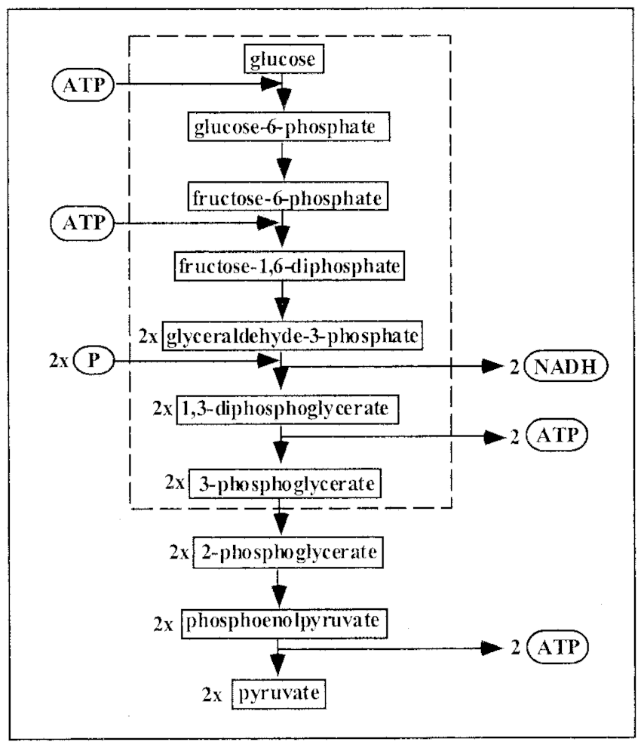

Slide 4
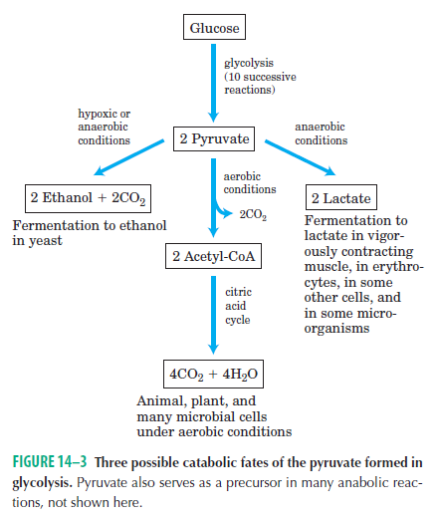
Various fates of pyruvate

Slide 5
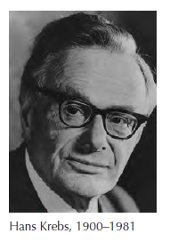
Cellular Respiration
Aerobic phase of catabolism is called respiration. In the broader physiological or macroscopic sense, respiration refers to a multicellular organism’s uptake of O2 and release of CO2. Biochemists and cell biologists, however, use the term in a narrower sense to refer to the molecular processes by which cells consume O2 and produce CO2—processes more precisely termed cellular respiration.

Slide 6
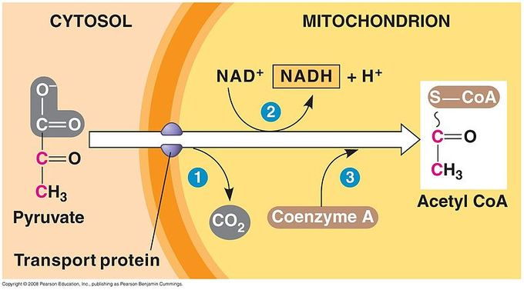
Acetyl CoA synthesis from pyruvate
Translocation from Cytoplasm to mitochondria

Slide 7
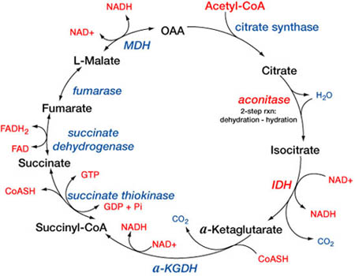
Kreb’s Cylcle/ TCA Cycle
Inside mitochondria

Slide 8
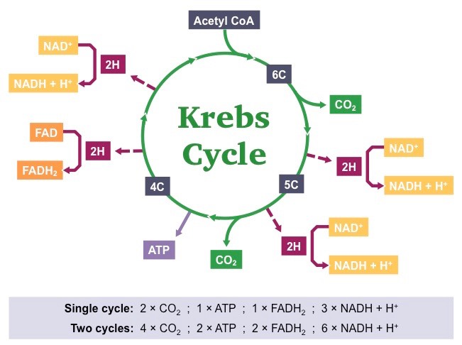
By products of TCA cycle

Slide 9
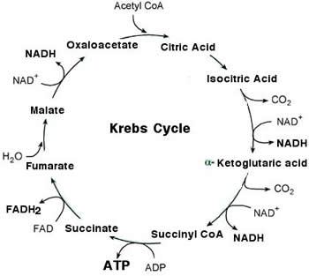
Major products of TCA Cycle

Slide 10
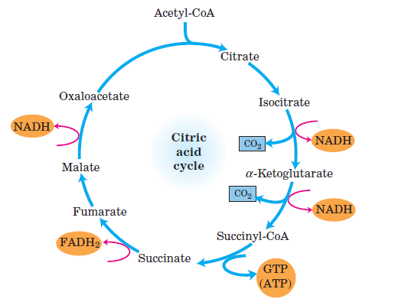
Kreb’s Cycle

Slide 11
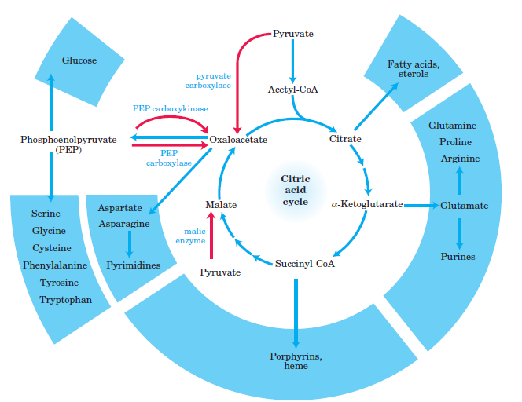
Kreb’s Cycle- other functions

Slide 12
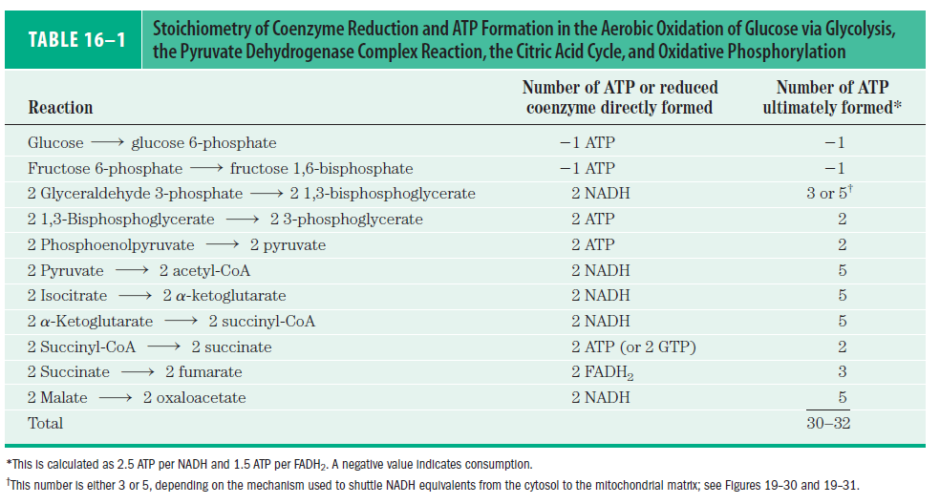
Kreb’s Cycle- Energy dynamics

Slide 13
By products of TCA cycle

Slide 14
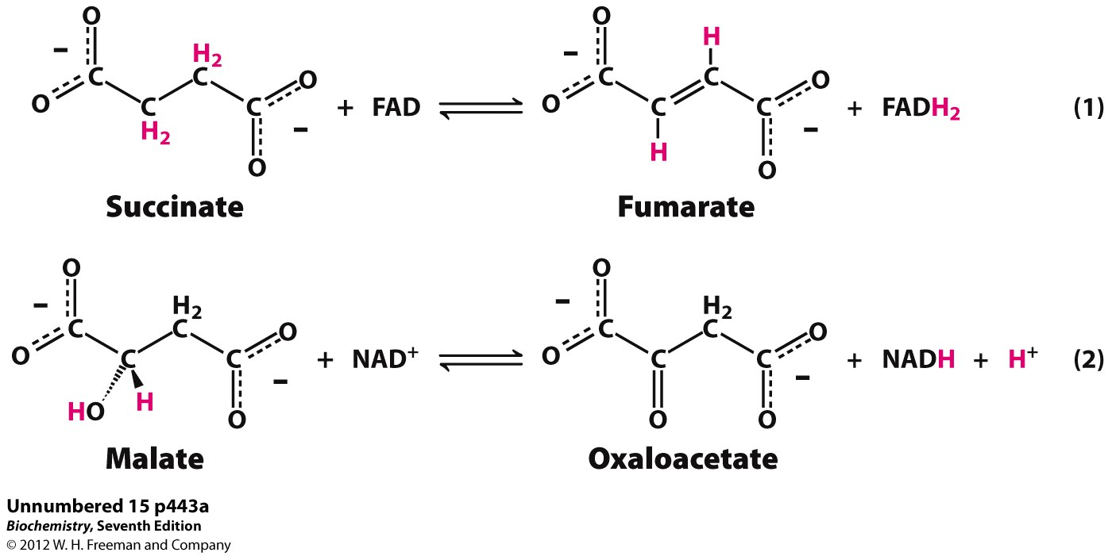
Key Redox reactions of the TCA

Slide 15
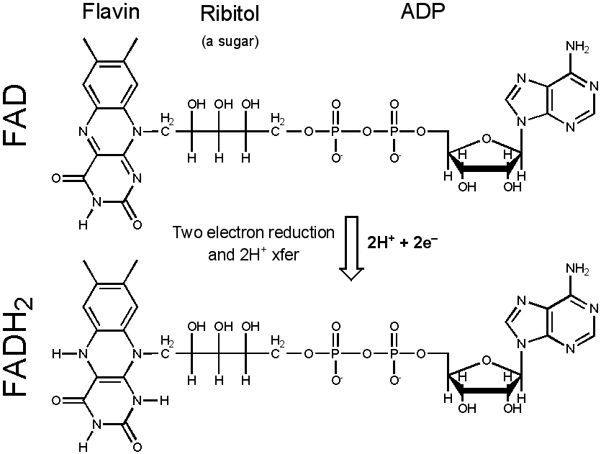
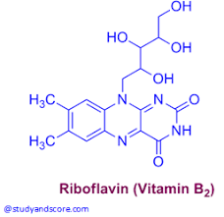
By products of TCA cycle

Slide 16
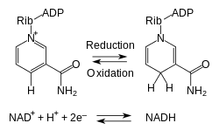
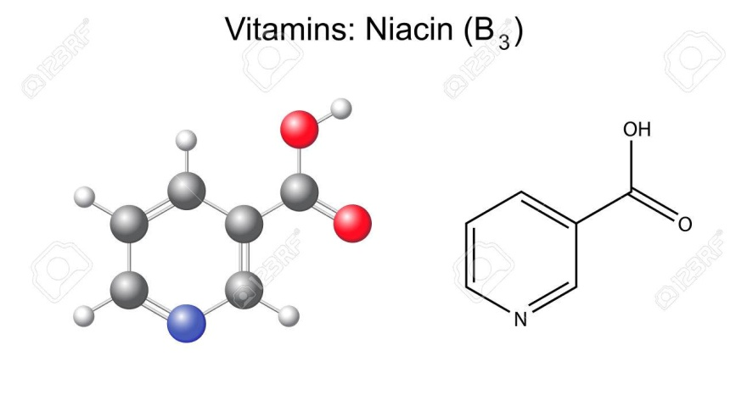
By products of TCA cycle

Slide 17
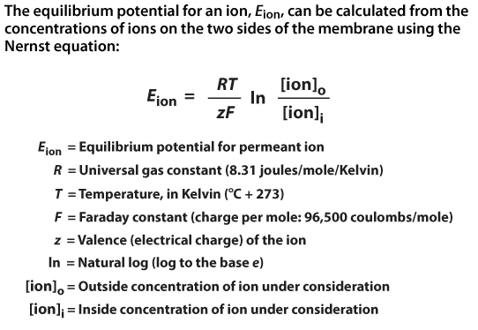
Nernst Equation

Slide 18
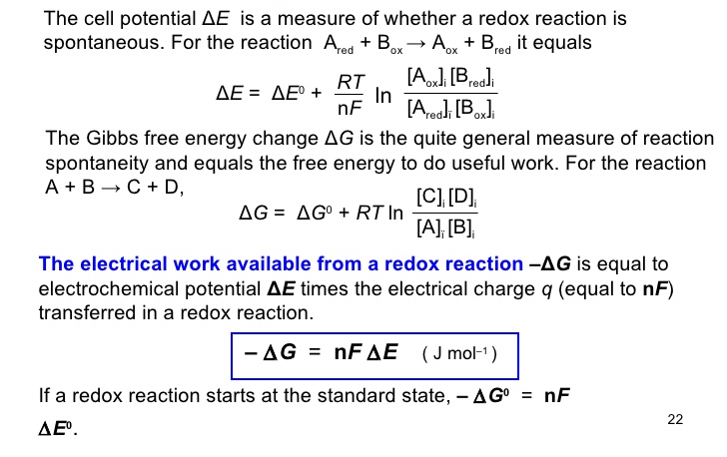
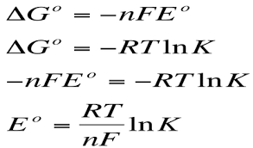
Gibb’s Free energy, Equilibrium constant and Electrochemical potential
Nernst Equation

Slide 19
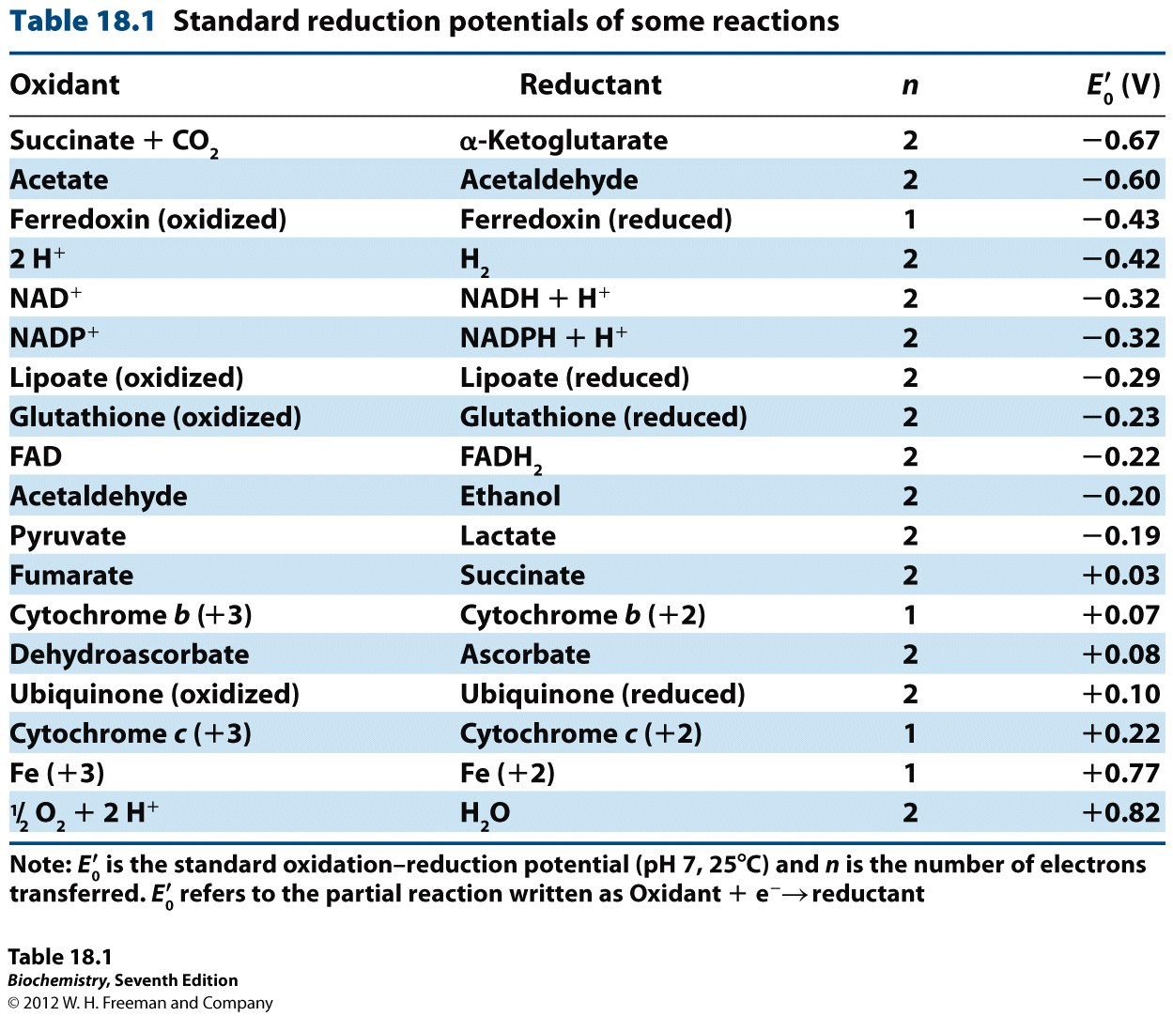

Slide 20
References:
1. Nelson And Cox, Lehninger Principles of Biochemistry, 6th edition
3. Images: Search engine Google.
4. Harper’s Biochemistry 26th Edition.
5. Genes- VIII, Lewin
6. Developmental Biology by Gilbert 7th Edition

